Slide 1
Criminal Justice
Coordinating Council
(my early concepts)
Jenny Daniel
Justice Initiatives Program Manager
Community Justice Department
jdaniel@missoulacounty.us

Slide 2

ABOUT ME
From Missoula
17 years @ Missoula County
Crime Victim Advocate Program--advocate & supervisor
2013 Just Response Coordinator & Grants Administrator
Believe most/all of our problems are a result of trauma and how we cope
Like to listen to all perspectives
WHAT I’VE LEARNED
We love collaborations & keep finding awesome solutions to problems—We also run the risk of working in group silos vs. organizational/role silos
It takes time and commitment to work together, but the result is smarter and longer lasting
This work is really about relationships and knowing who to call & learning about each other’s roles & motivations
Teamwork is a protective factor for burnout and secondary trauma
Notes:
We also run the risk of working in group silos instead of Org silos.

Slide 3
TODAY
Review our July 8th Planning meeting
Conceptualizing where we are
We have a ton of groups & projects!!
Working toward more integration & cross communication
Notes:
We also run the risk of working in group silos instead of Org silos.

Slide 4
Planning Meeting Review
DISCUSSION TOPICS
Revisiting/affirming understanding of the purpose/mission of the Council
Drafted Guiding Principles
Strengthening organizational structure - Expectations and obligations

Slide 5
Planning Meeting Review
Positives & Disappointments quoted from the Report
Pre-trial services have been refined… better implemented.
The jail review was completed (but needs further analysis).
Justice and District Court are more unified and consistent.
Crisis intervention services are improved and continuing.
There seems to be better attendance and increased interest in the Council.
We’re reporting out to the community.
As a Council, we need to be better informed and educated on Best Practices and the research behind them.
Better communication is needed
Some members don’t feel attached to the Council or find reason to participate.

Slide 6
Draft Guiding Principles:
Planning Meeting Review
We believe in human dignity and that all individuals have value.
We believe that when a person’s basic needs for safety, housing, food, and medical care are met, they are more likely to be successful in the legal arena and vice-versa.
We recognize that inequities exist in our system, and we work to address inequities in our policies and decisions.
We believe that public resources should be spent on effective, research-based practices.
We consider and evaluate decisions & solutions based on objective data.
We believe that a shared base of information and data will result in stronger, durable actions and decisions.
We believe that it takes courage to face the risks needed to improve the criminal justice system and as a Council, we are willing to take that risk.
We take responsibility for reviewing and evaluating our practices on a regular basis.
We believe that a variety of responses are appropriate and necessary for justice-involved people and that incarceration is only part of a strategy.
Notes:
Please add your guiding principles thoughts to the chat

Slide 7
RELATIONSHIPS
COMMUNICATION
COORDINATION
COMMUNITY SAFETY
PEOPLE’S DIGNITY
Pre-trial/Public Safety Assessment
State’s pilot project
Advisory Board
Case Review Response Team
Child Abuse & Sexual Assault System Review
Juvenile Justice
Recognize the unique position of juveniles in the system
SJC Implementation Team
Grant sets the charter
Family Violence Intervention Sessions
Class for defendants of family violence
Lethality Assessment Program
Risk Assessment Tool
Criminal Justice Coordinating Council
Partners for Re-integration
Exchange of ideas, support, resources, weaving solutions
Safety & Justice Challenge
Reduce Jail Overcrowding & Address disparity
Just Response
Improve Response to Crime Victims
Strangulation
Education & System Response
Missoula Human Trafficking Task Force
Jail Review Team
Revisit Charter
Vicarious Trauma Initiatives
Organizational support & improving response to workers
CIT Program
MST rogram
Restorative Justice
Justice Alliance for Behavioral Health
Executive Committee
Strategic Alliance for
Improved Mental Health
Conceptualizing Our Work
Notes:
What am I missing on this page?

Slide 8
RELATIONSHIPS
COMMUNICATION
COORDINATION
COMMUNITY SAFETY
PEOPLE’S DIGNITY
Criminal Justice
Coordinating
Council
PEOPLE
DEFENDANTS
VICTIMS
FIRST RESPONDERS & PROVIDERS
HOUSING AFFORABILITY/
HOMELESSNESS
CRIMINAL
JUSTICE
INVOLVED
SUBSTANCE
ABUSE
BEAHVIORAL
HEALTH
TRAUMA
Conceptualizing Our Work
Notes:
Issues

Slide 9
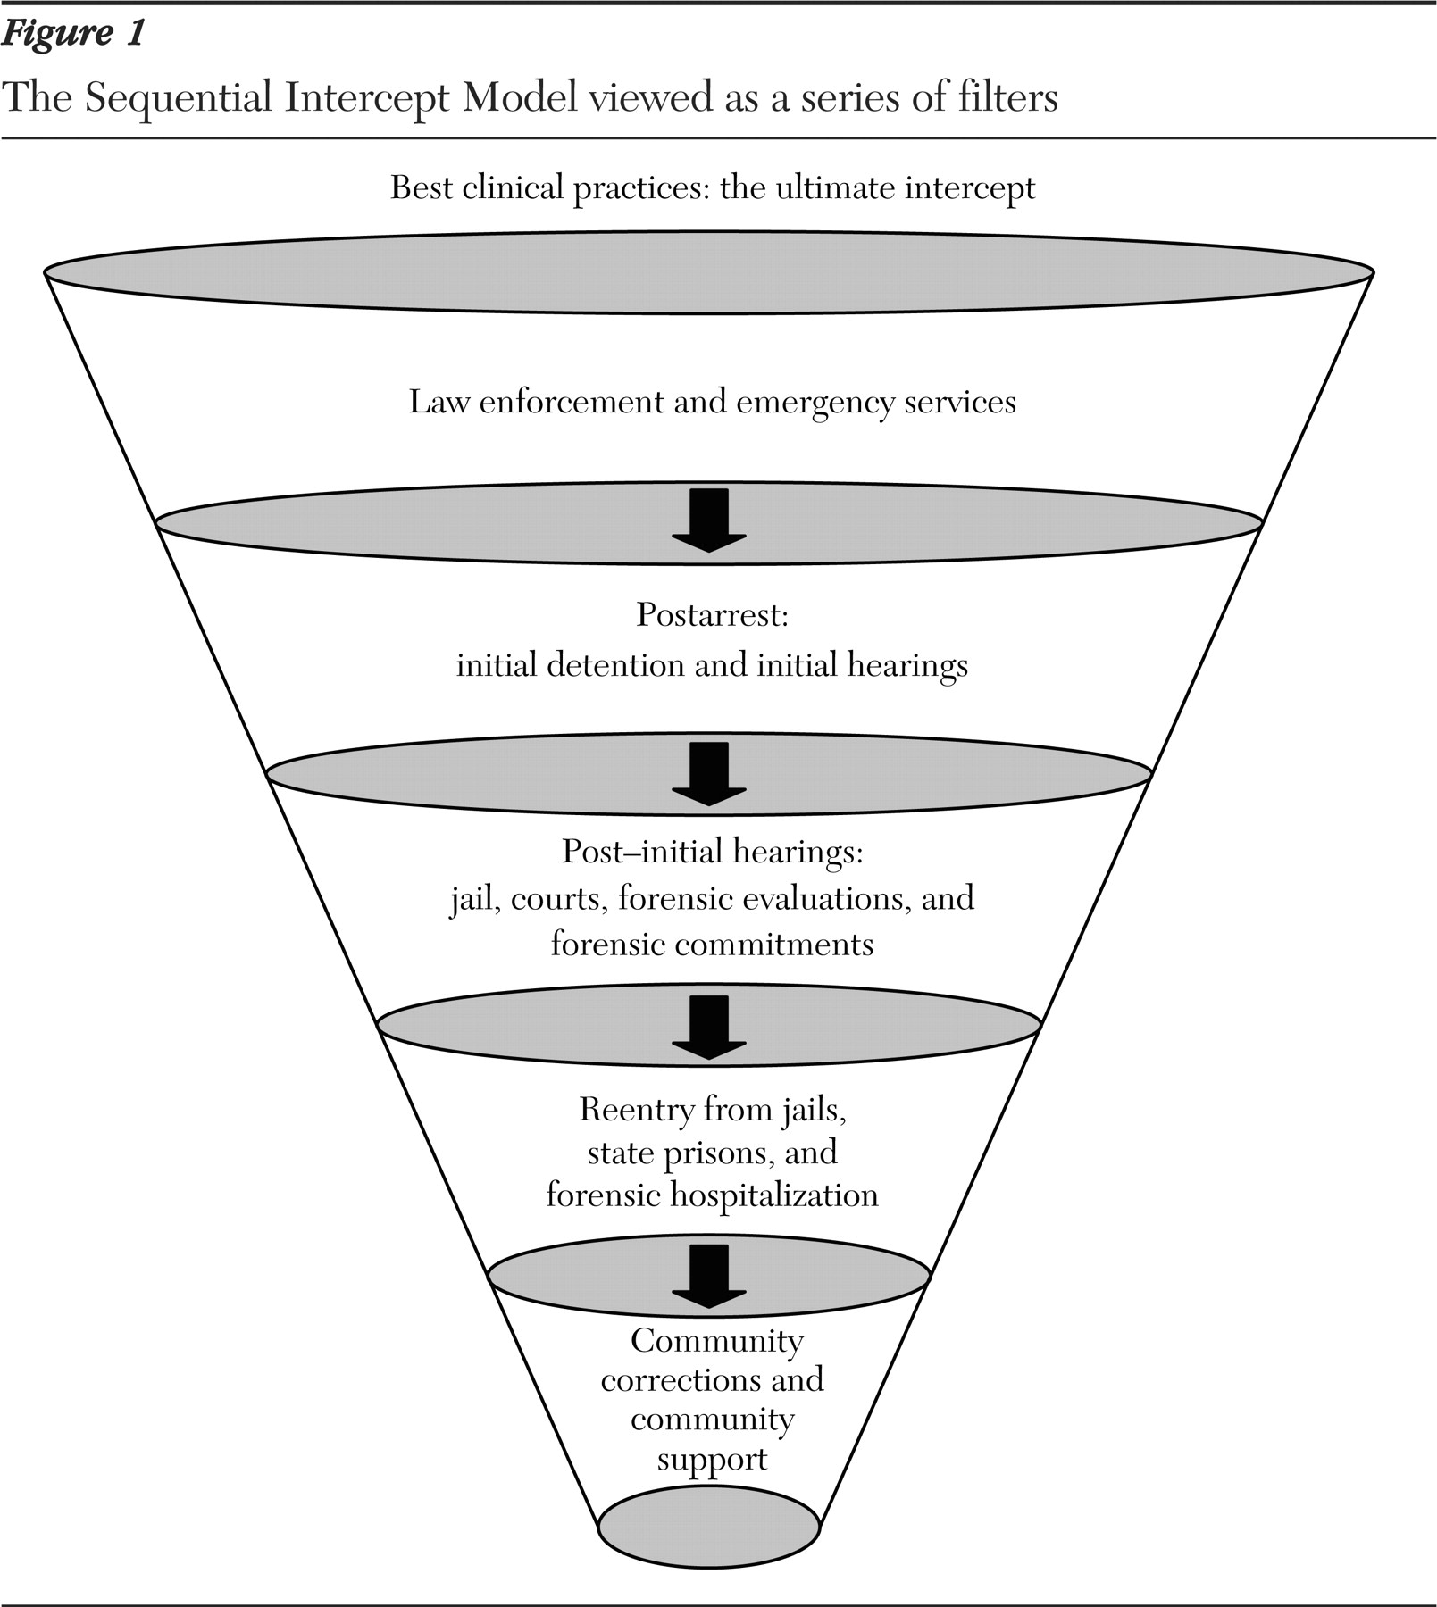
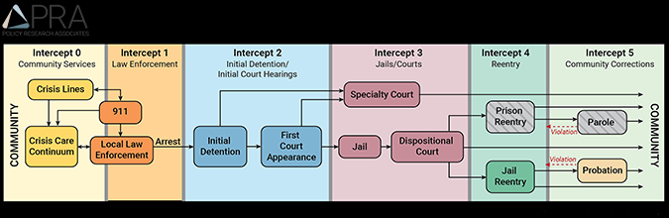
Conceptualizing Our Work
SIM-Sequential Intercept Mapping
LEADERS-EXECUTIVE & ADVISORY BOARDS
Behavioral Health + Substance Intervention
Teams
TRAUMA
=
Behavioral Health Intervention
Behavioral Health Follow Up
Just Response Teams—improving response for people harmed by crime

Slide 10
NEXT STEPS
JENNY
YOU
“Ride-a-longs” + Groups + Individual meetings
Develop CJCC structure with Executive Committee
Hire SJC & JR Coordinators
Support expert working groups
Support partners
Share training opportunities
Work on Communication avenues
jdaniel@missoulacounty.us
Join us Wed 8/11/2021 9:30 AM - 11:00 AM to hear about Pennington Care Campus
Site visit SJC project: SJC Partners! Save the Dates: 8/24-8/26
Stay connected & give me feedback
Contact me with your interests & training needs
Notes:
https://www.safetyandjusticechallenge.org/challenge-site/pennington-county/

